Slide 1
Pathways: How can we be Successful?

Slide 2

Poll Everywhere
Get out your device and go to in your browser
PollEV.com/matthewville304
D106

Slide 3
Old vs New
Pathways
Over 300 competencies
Cheaper
You can access it anywhere
Can print it or save it as a PDF on your computer
Save trees
Takes a little time to get use to, sometimes difficult to find evaluations
Old Educational
Print
Something tangible
Toastmasters International shipping, could take a while to get new book
D106
Notes:
Did you know - "The old education program teaches 68 competencies; Pathways adds more than 250 competencies members can learn." https://www.toastmasters.org/Magazine/Articles/The-Possibilities-of-PATHWAYS
Pathways was developed with these benefits for members:
Recognition that comes earlier and more often in the educational journey
New technological resources to improve speeches and support meeting roles
Mobile access to educational materials (tablets)
Expanded video and digital content to facilitate learning among our global community of members
Stronger evaluation and mentoring components

Slide 4
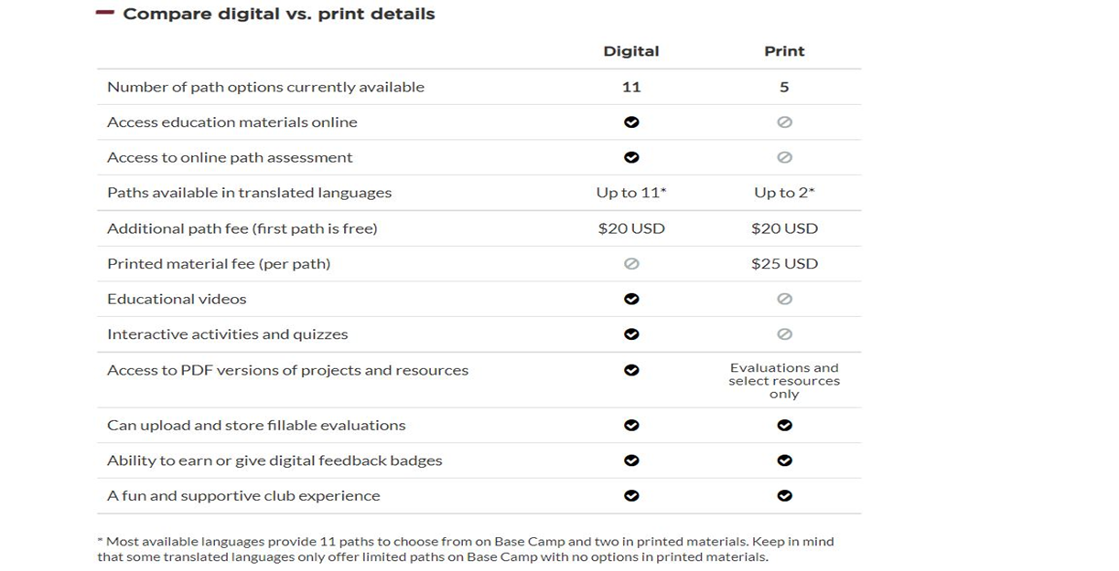
Notes:
Compare the two, talk about the positives of pathways.

Slide 5
What path works for me?
Go through the questionnaire once you sign into the webpage
Pick which one you think best suits you
Takes up to 24 hours to appear
You can change it within 30 days if you don’t like it just by emailing education@toastmasters.org
Use the navigator guide under pathways to help
Note: Turn your pop-up blocker off
D106

Slide 6
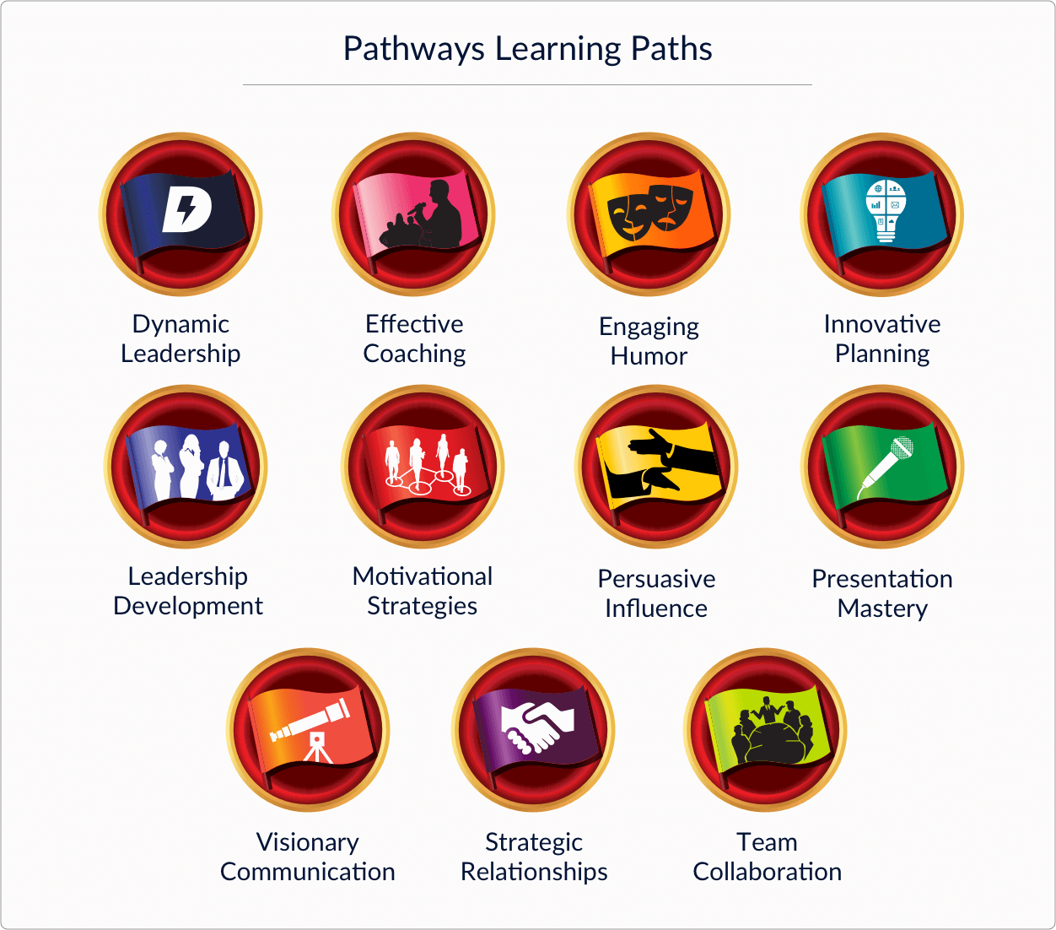
D106
Notes:
Members advance through their paths in five levels of progressing complexity. The levels are defined this way:
Mastering Fundamentals
Learning Your Style
Increasing Knowledge
Building Skills
Demonstrating Expertise
The idea is to build on what you learned in the previous level. The goal throughout the Pathways program is to not just learn, but to apply what you learn.

Slide 7
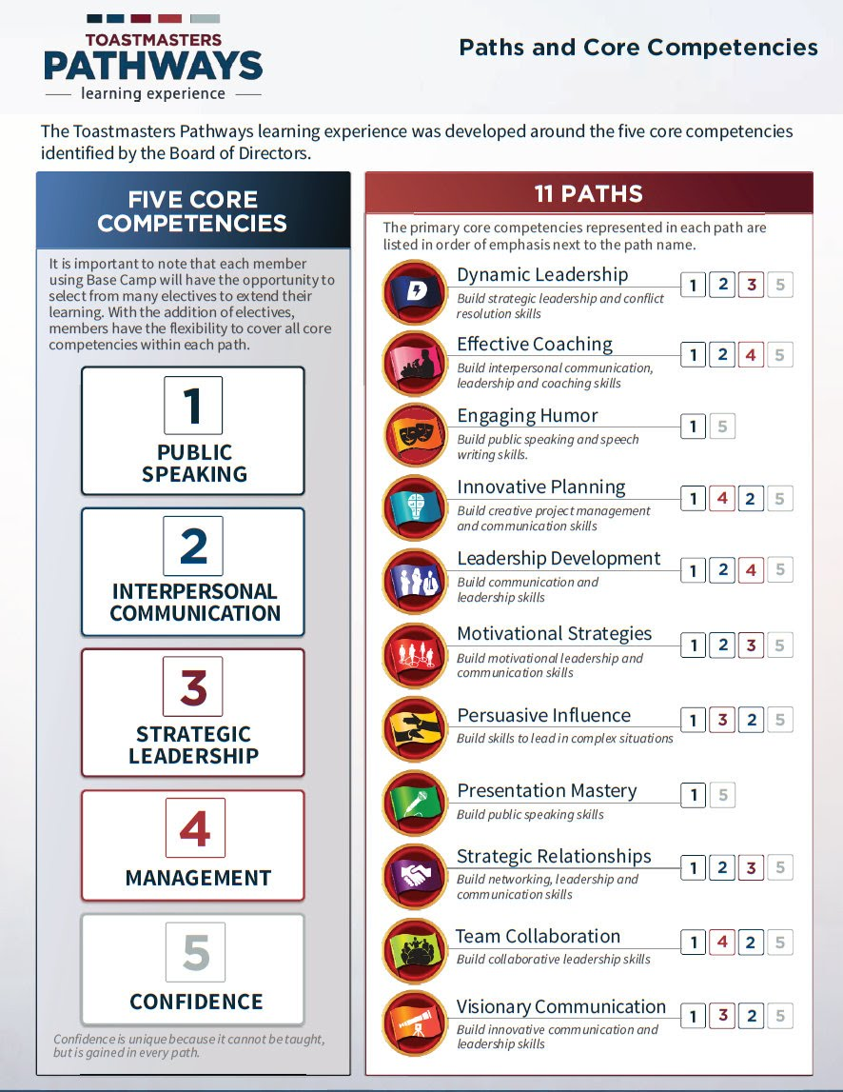
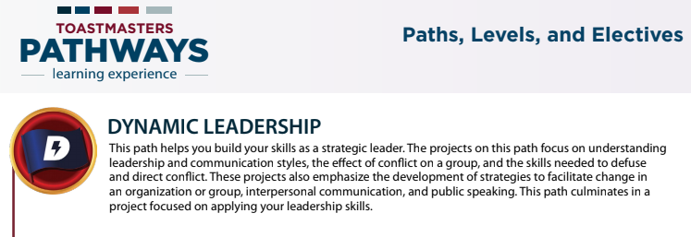
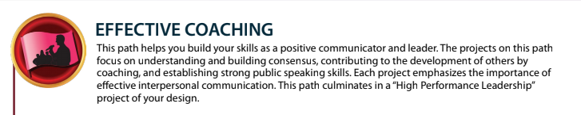
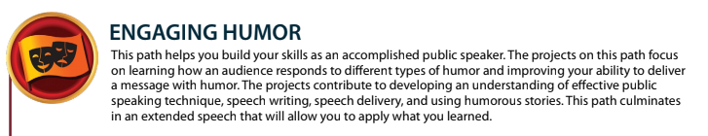
D106
Notes:
The Pathways Paths and Core Competencies document is located in the Google Drive sent to you and is very helpful and relevant for providing examples for the ways a path will build your skills, and in what!
Really hit home how this can benefit life and make it.
For example:
Dynamic Leadership - build your skills as a strategic leader - This path helps you understand leadership & communication styles, how to defuse and direct conflict in groups. You can also learn how to facilitate change in organizations all through the projects in this path!

Slide 8
Have you heard this before?
“I’ve finished so much of the old education path, and want to get to the “meat and potatoes” of Pathways. Can I skip Level 1?”
Ask this question in return, “how many CC (Competent Communicator) manuals have you completed? Level 1 is similar to this!”
When ever you go through Level 1, incorporate aspects of the Path itself, why you chose it, etc. as an extra challenge. Have all of your members heard you give an Icebreaker before??

Slide 9
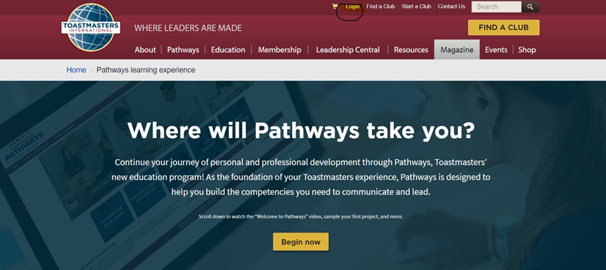
Notes:
Quickly reference site, remind people how to access pathways. What happens when you login in, name will change up here. You can either go to pathways menu or click on your name. Number of ways you can access pathways. Very quick overview. We will be having sessions on how to access pathways later on in the summer.

Slide 10
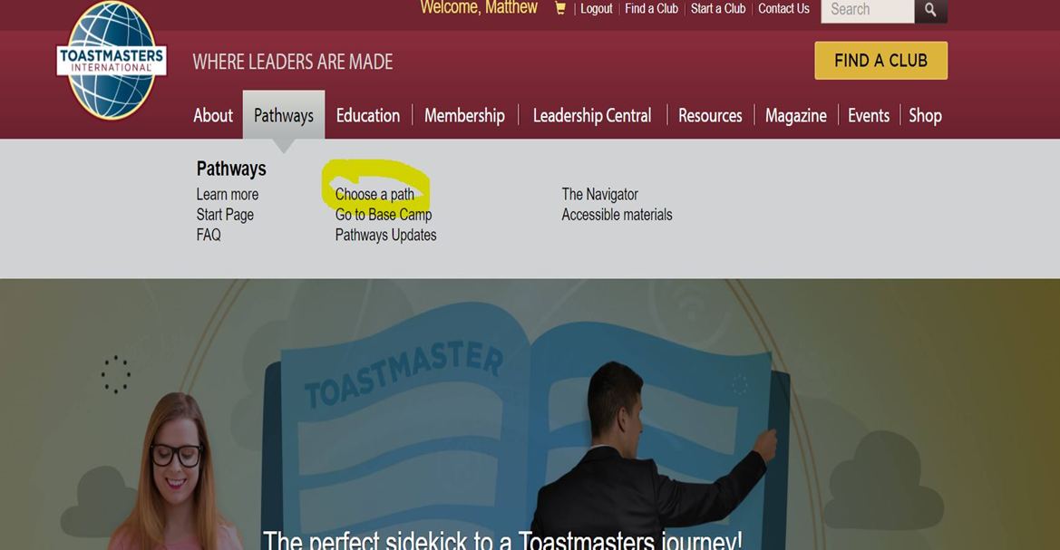

Slide 11
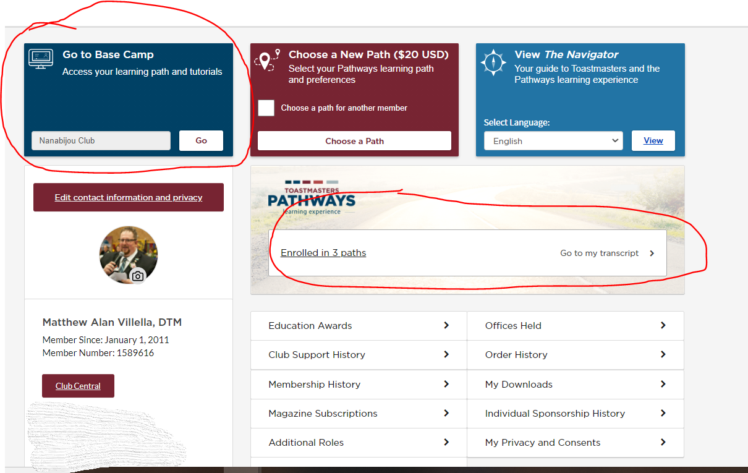
Notes:
Tell them about the two different ways on this screen to get into pathways as well.

Slide 12
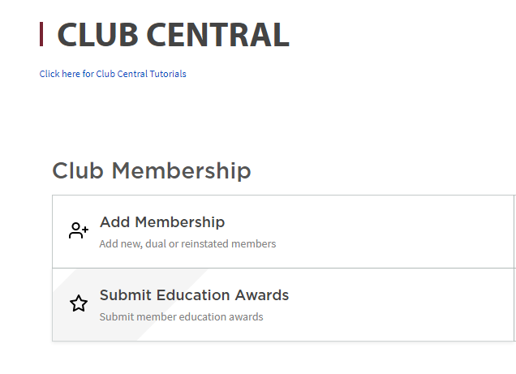
Level Approval Process - Important
Two-Part process (VPE, Pres, Sec):
Review and approve Level Completion in Base Camp Manager
Go to your Toastmaster International profile
  Click Club Central button
  Submit Educational Award
Notes:
Really address how important this is.

Slide 13
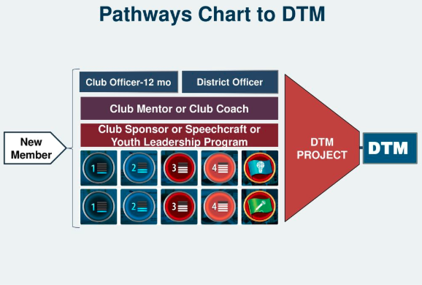
D106

Slide 14
DTM
The Distinguished Toastmaster award is the highest recognition in Toastmasters. To be eligible for the award, you must have earned the following:
  Two paths completed up to Level 5
  Serve in 4 leadership roles
  Complete the DTM Project
    Need to request “project access” from Toastmaster International.
    Once a member has completed one path and three levels of another path, they can have this project added to their base camp account.
    This request must be submitted to World Headquarters by phone or email.
      1-720-439-5050 or EducationProgram@toastmasters.org
D106
Notes:
The Distinguished Toastmaster award is the highest our organization bestows. The DTM recognizes a superior level of achievement in both communication and leadership.

Slide 15
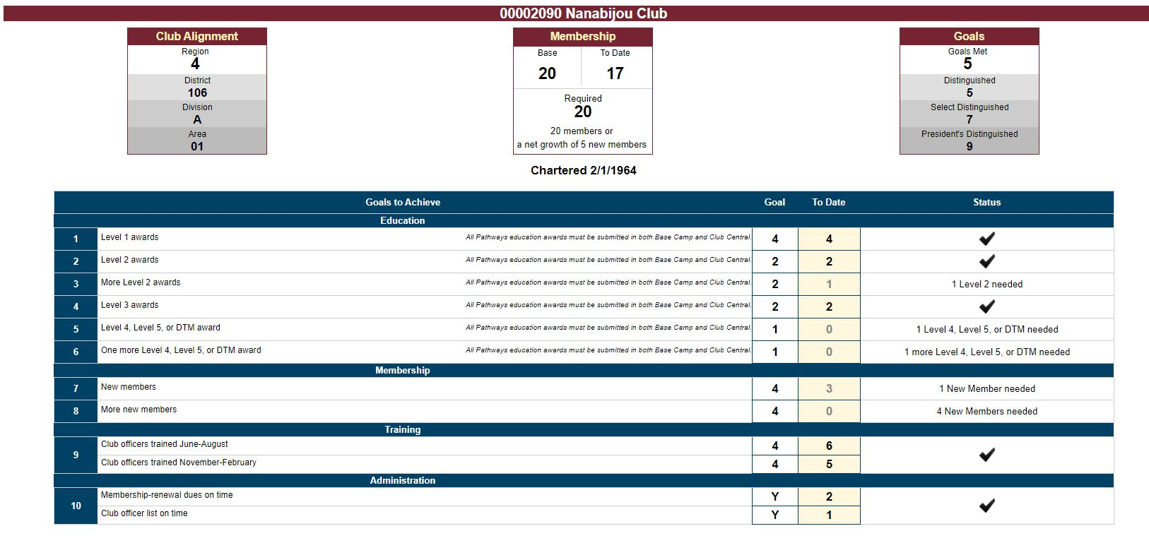
Distinguished Club Plan-DCP
Notes:
The Distinguished Club Program (DCP) is an annual award program recognizing clubs that provide an outstanding member experience. You play a vital role in your club’s participation in the DCP through your achievements. There are six educational DCP goals you and members of your club can fulfill:
Four members complete Level 1 in a learning path
Two members complete Level 2 in a learning path
Two additional members complete Level 2 in a learning path
Two members complete Level 3 in a learning path
One member completes Level 4 in learning path
One member completes Level 5 in a learning path

Slide 16
Who should know about the DCP?
President?
VP of Education?
VP of Membership?
All Officers?
If your club hasn’t regularly discussed the DCP, it’s a great topic to get onto your officer agenda early in the year!
Your President can kick it off,
VPE can answer questions from members
But, all officers should know about the Club’s DCP plan

Slide 17

D106

Slide 18
How do we become successful?
Have someone in the club act as a pathways mentor- this person can field questions and help participants. Spend 1-1 time with every new member.
Have someone within the team to know how to access evaluations
Prior to speech send out your evaluation.
Exchange emails within your club.
Go in and practice!
D106

