Slide 1
Officer Club Training 2021:
Mentorship

Slide 2
Goals:
Why is Mentorship important to Toastmasters?
What resources are available to our Mentors through Toastmasters International?
What are the qualities of a good Mentor?
How to be a good Mentee.
Lollipop moments and additional resources.
D106

Slide 3
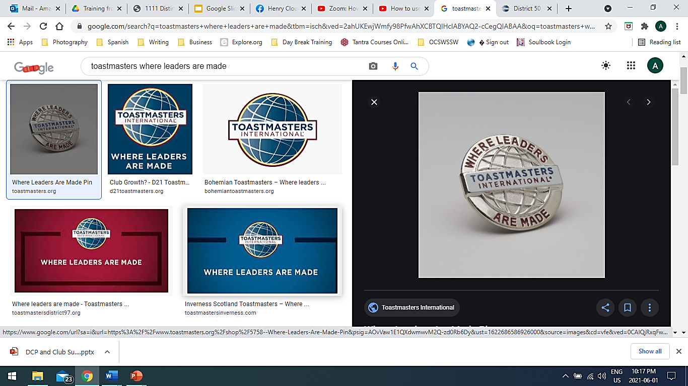
Write in the chat: Who have been your most influential Mentors?

Slide 4
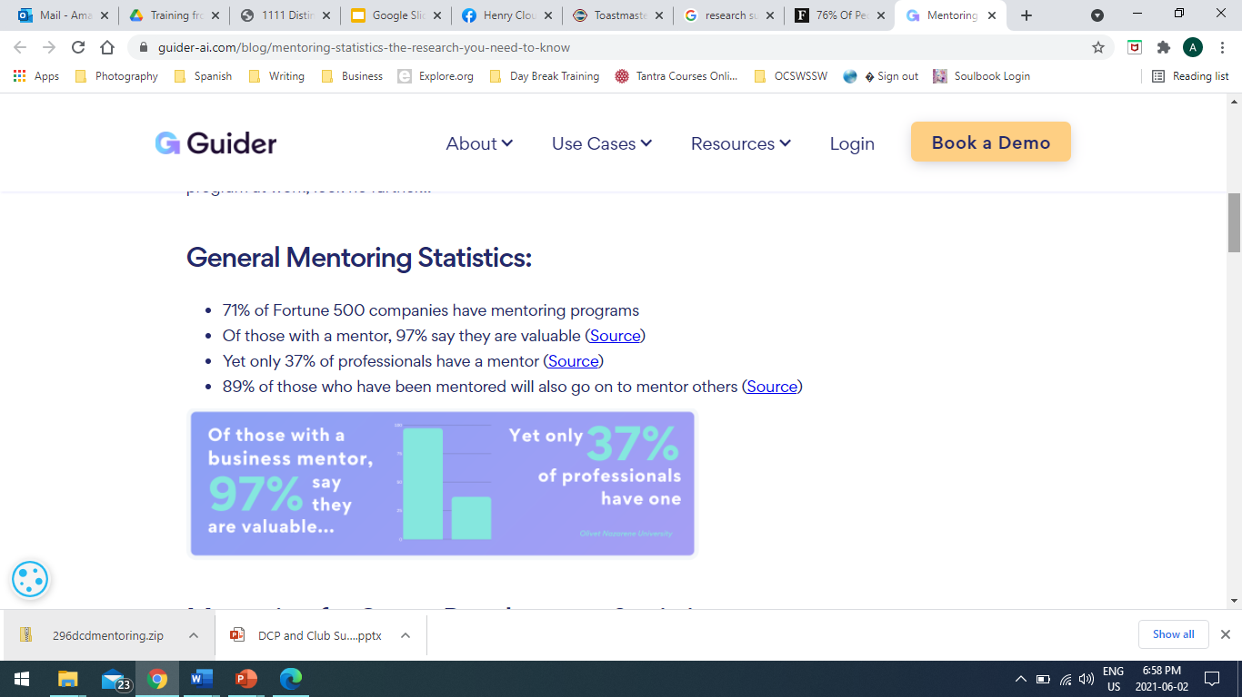
Why is Mentorship Important?

Slide 5
Toastmasters International Resources
Mentoring: https://www.toastmasters.org/resources/mentoring
  Mentoring: Successful Club Series
  How to Manage Your Club’s Mentoring Program
  Mentor Interest survey
  Mentor Assignment Notice/Responsibilities When Mentoring a New Member
  Mentor Certificate
Pathways: Prepare to Mentor, Level 3 Project
Toastmasters Magazine: Google search “Toastmasters International Mentorship”
District Leadership Projects: Mentoring a Club https://www.toastmasters.org/leadership-central/district-leader-tools/training/club-sponsor-mentor-and-coach-training

Slide 6
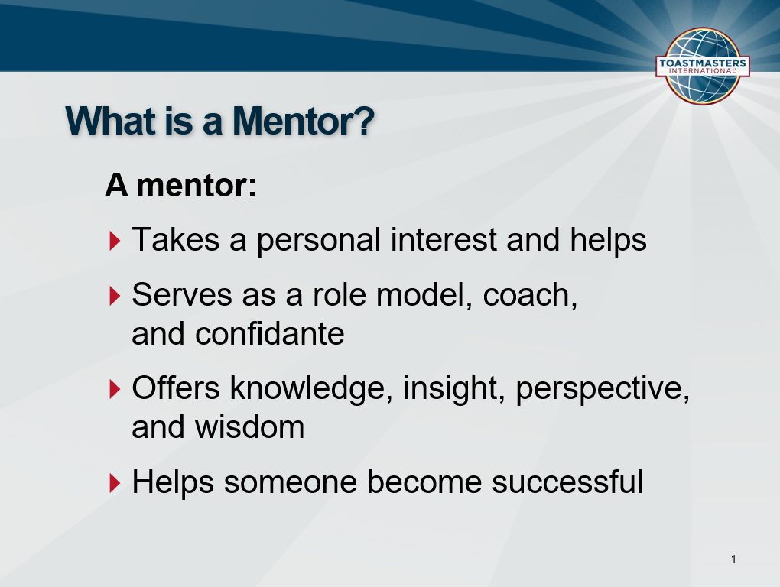
Time to hit the Polls!

Slide 7
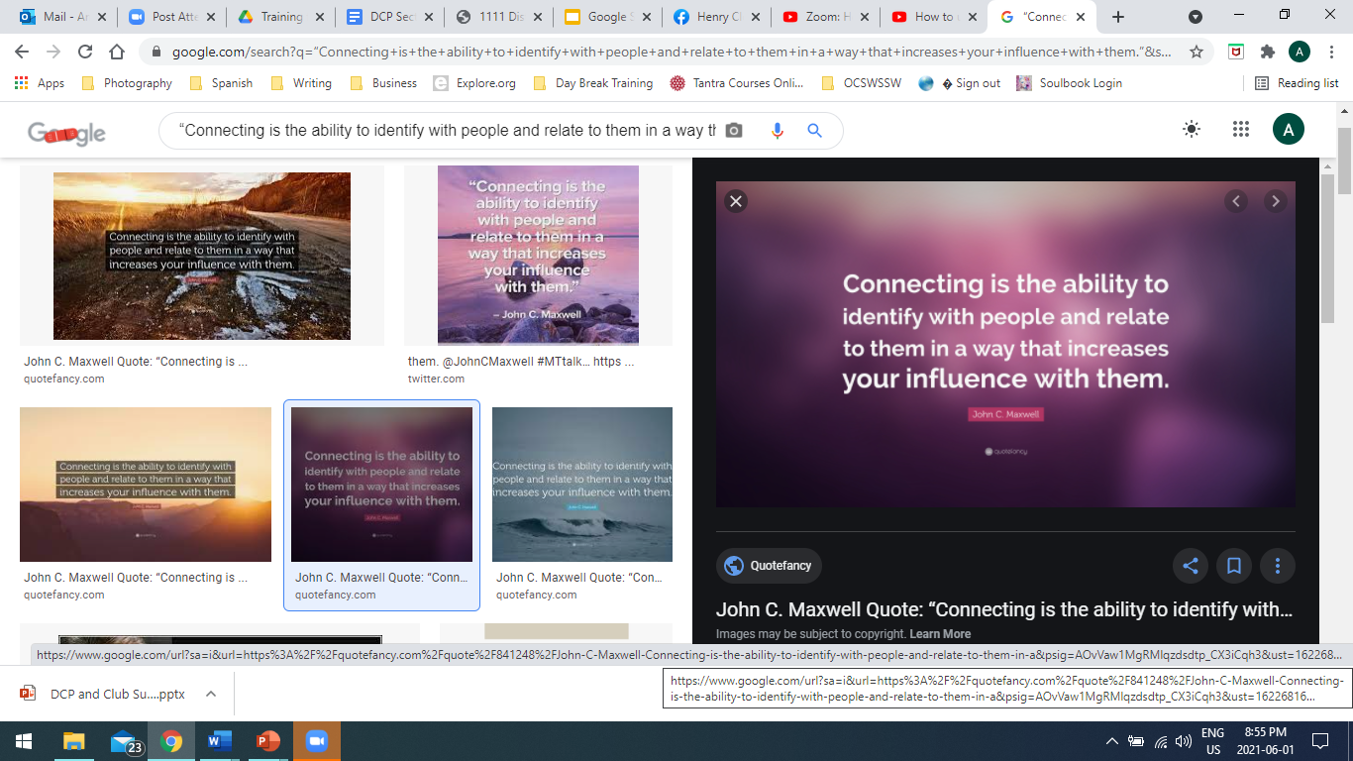

Slide 8
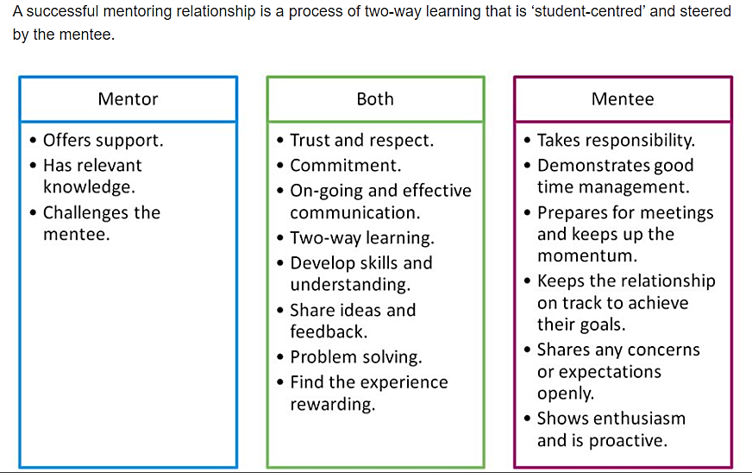
(Source: https://intranet.birmingham.ac.uk/as/employability/careers/mentoring/mentoring-schemes/the-mentoring-relationship.aspx)

Slide 9
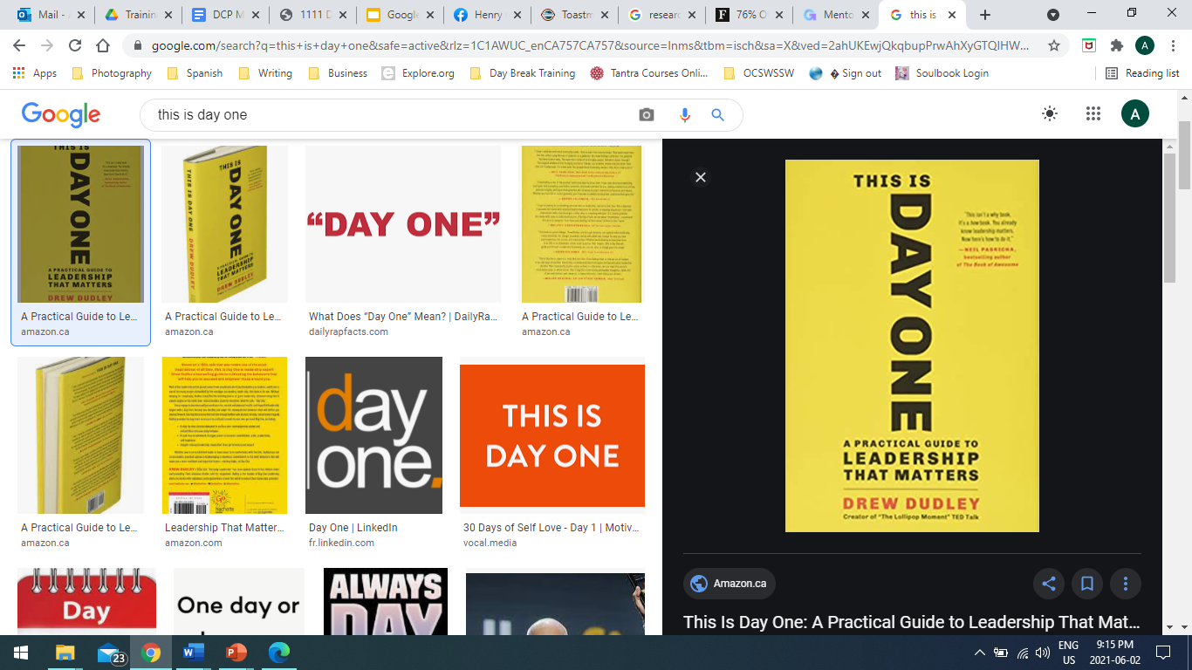
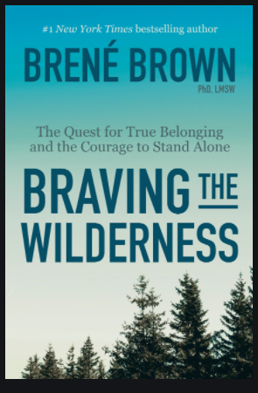
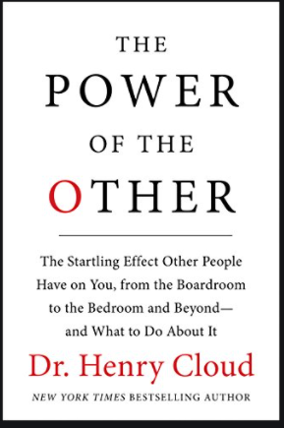
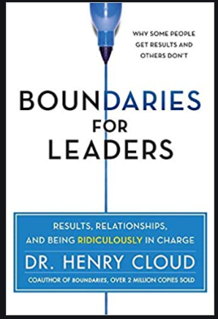
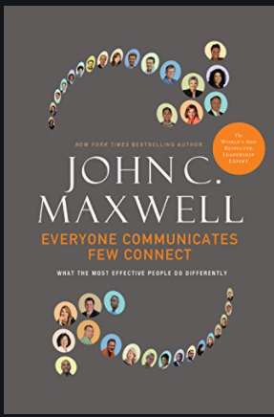
Lollipop Moments and Additional Resources
Drue Dudley TEDx talk “Everyday Leadership (the Lollipop Moment)” https://www.ted.com/talks/drew_dudley_everyday_leadership?language=en

