Slide 1
Develop Your Leaders From Within
Transform your talent with Toastmasters
Notes:
Today, I’d like to talk to you about how, with a little help from Toastmasters International, you can transform your talent and develop your leaders from within.

Slide 2
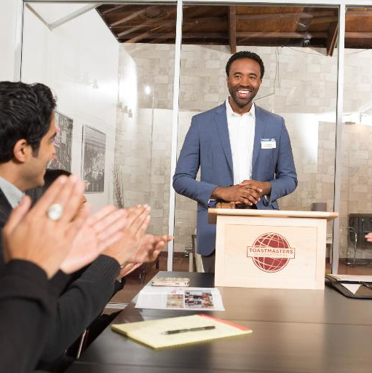
What is Toastmasters?
A worldwide nonprofit educational organization that empowers people to become more effective communicators and leaders
A network of over 352,000 members in more than 16,400 clubs across 141 countries
A nearly 100-year-old company known for public speaking, communication and leadership development that has evolved to meet the needs of today’s professionals
The largest provider of dynamic, high-value, experiential communication and leadership skills development in the world
Notes:
Let’s start by explaining what Toastmasters is. Toastmasters is a worldwide nonprofit educational organization that empowers people to become more effective communicators and leaders. We are a network of over 352,000 members in more than 16,400 clubs across 141 countries. The organization has been around for nearly 100 years and has built a strong reputation for training individuals in public speaking, communication and leadership. Over the years, the organization has evolved to meet the needs of today’s professionals. Toastmasters International is the most effective provider of dynamic, high-value, experiential communication and leadership skills development in the world.

Slide 3









Who uses Toastmasters?
More than half of Fortune 500 companies have Toastmasters clubs
Notable corporate clubs:
Notes:
Toastmasters clubs are offered by companies all over the world and throughout several industries. Over half of Fortune 500 companies offer clubs to their employees. Some of the biggest names in the world host Toastmasters clubs, including Apple, Google, Toyota, Coca Cola, Disney and Boeing.

Slide 4

Benefits of forming a Toastmasters club
Benefits of forming a Toastmasters club
Foster career advancement
Augment existing training programs
Provide employees with an added benefit
Build team camaraderie
Encourage employee retention
Strengthen the leadership bench
Notes:
Starting a Toastmasters club at your company can help in many ways. You can help foster career advancement for your employees by building up their communication and leadership skills. A Toastmasters club can also help augment your existing training programs. Meetings are a great place for employees who normally don’t interact with each other to get to know one another and build team camaraderie. Offering a Toastmasters club can also encourage employee retention. Now, more than ever, employees are looking to build skills and a Toastmasters club is a cost-effective way to do so. Employees will see your Toastmasters club as an added benefit that your company offers. Through this all, you will strengthen the leadership bench in your company.

Slide 5







Employees will learn to:
    Conduct effective meetings
    Practice time management
    Enhance their listening skills
    Sharpen their presentation skills
    Boost team collaboration
    Guide successful teams
    Take and implement feedback
Notes:
Through Toastmasters, your employees will learn several skills that they can translate to their jobs. Employees will learn how to conduct effective meetings, saving your company time and money. They will enhance their listening skills and sharpen their presentation skills. The Toastmasters club will boost team collaboration. Along the way, employees will learn to guide successful teams and how to take and implement feedback, leading to tremendous career growth.

Slide 6
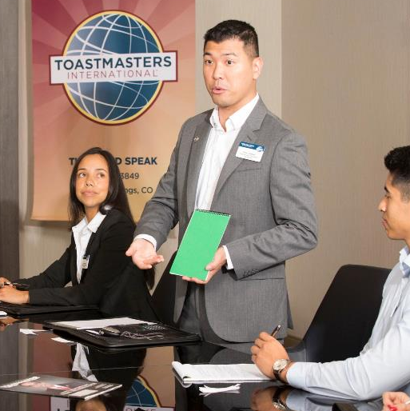
The Toastmasters club experience
Hands-on learning environment
Practice prepared and impromptu speeches
Receive feedback and evaluations in a supportive environment
Opportunities to lead at every meeting
Access to a mentor
Notes:
Clubs meet as often as you would like them to, with most meeting once a week. The club is a hands-on learning environment that provides your employees with opportunities to give both prepared and impromptu speeches. After their speeches, they will receive honest, encouraging and structured evaluations from their peers and will have the ability to implement the feedback in a later speech. Each meeting has volunteer leadership roles for your employees to fill, including the Toastmaster, Evaluator, Ah-Counter and Grammarian. This allows your employees to serve in a variety of leadership roles and pick up essential skills along the way. Plus, new members will have access to a mentor, who can help them out and advise them on an array of topics.

Slide 7

What is the Pathways learning experience?
Pathways is Toastmasters’ education program
Each employee receives one free path to start
Choose from 10 paths based on individual goals
Use Pathways online or in print
Work at your own pace
Build professional skills
Notes:
The Pathways learning experience is Toastmasters’ redesigned education program. Pathways focuses on five core competencies and 10 specialized learning paths, with more to come. Each employee receives one free path to start, and they are able to attempt multiple paths at the same time. When employees first log into Base Camp, which is the home of Pathways, they will take an assessment that will recommend three paths for you. Employees are free to choose any path they want! All resources and projects are available online or in print. Best of all, they can work at their own pace and learn valuable skills that will translate to their professional lives. The combination of the Pathways learning experience with the supportive environment found in our clubs is what makes Toastmasters such a powerful tool.
*Pathways is available in Arabic, English, French, German, Japanese, Portuguese, Simplified Chinese, Spanish, and Traditional Chinese. If any of these alternative languages apply to their company, mention their availability*

Slide 8
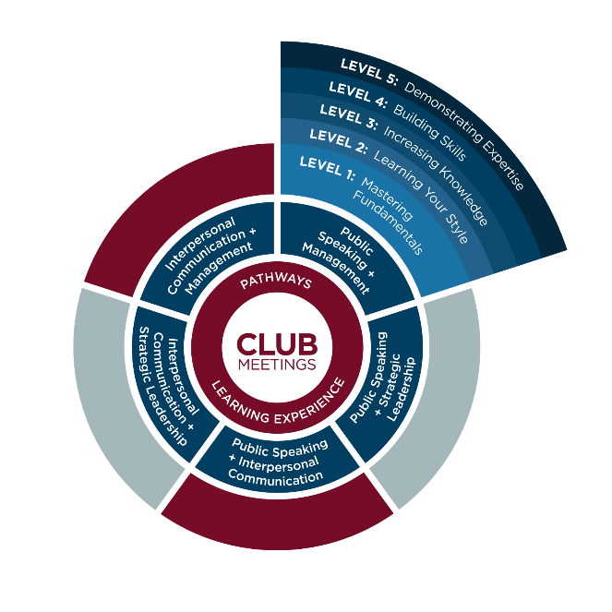
A glimpse into Pathways
Notes:
Here, you can see a little bit about how Pathways works. Everything is centered around the club meetings. Employees can go home and spend time in Pathways, choose their path and see what their current assignment is. Within each path, there are five levels. Employees will start by Mastering Fundamentals, then Learning Your Style, Increasing Knowledge, Building Skills and finally, Demonstrating Expertise. This method allows employees to build skills at their own pace.

Slide 9
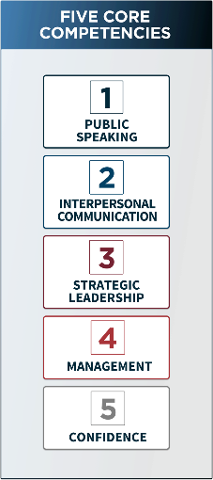
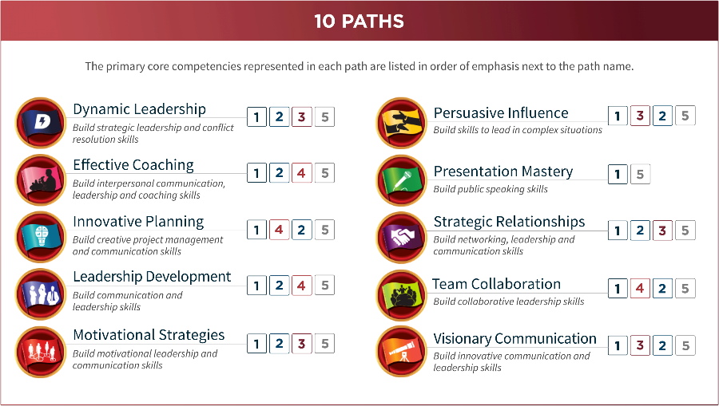
A closer look into Pathways
Notes:
Here’s a glimpse into what Pathways looks like, the current 10 paths and the five core competencies. More paths are being worked on currently. The five core competencies are Public Speaking, Interpersonal Communication, Strategic Leadership, Management and Confidence. Confidence is unique because it cannot be taught, but is gained in every path. In each path, employees learn multiple competencies. For example, if they wanted to work on their Public Speaking, Interpersonal Communication and Management, the Leadership Development path is right for them. Or, if they wanted to learn about Persuasive Influence, the core competencies they would learn are Public Speaking, Strategic Leadership, and Interpersonal Communication. In all of these paths, there are over 300 competencies employees can learn.

Slide 10
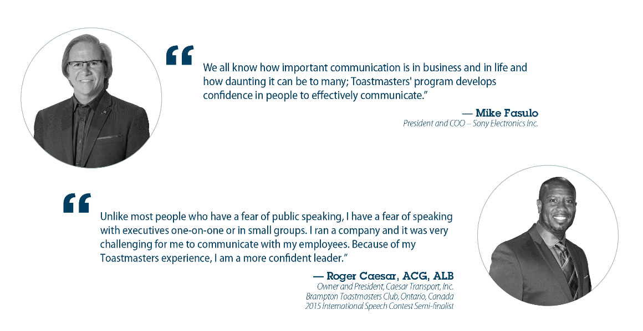
Testimonials
Notes:
Toastmasters has helped all levels of professionals. It gives career advancers the skills they need for advancement, it gives mature managers the tools to overcome obstacles in their career paths, it helps young professionals master soft skills that 90% of employers are looking for and it provides international professionals the chance to improve their speaking and writing skills. Employees and CEOs alike have had Toastmasters transform their careers. Here’s what members have said about their experiences with Toastmasters.

Slide 11
Break barriers, not your budget
Compared to conferences and seminars, Toastmasters is ongoing and affordable
Most cost-effective way to learn
Learning occurs on-site or locally
$125 USD charter fee
$20 USD new-member fee per person
$45 USD six months’ membership dues per person
Notes:
Toastmasters clubs are inexpensive to set up, and unlike other programs, the learning never stops. It offers the most cost-effective way to learn. And you can learn locally, either holding your club meetings on-site or at a local location. No more having to send employees away, pay for airfare and hotel rooms for them to learn at a conference. There is no other company that offers what Toastmasters offers in this model. It costs $125 USD to charter a new club. A new club requires 20 members to start and there is a $20 USD per person fee for all new members. After that, six months of a Toastmasters membership only costs $45 USD per member. Keep in mind that sending one person to a Dale Carnegie three-day seminar can cost upwards of $2,000 USD!

Slide 12
Toastmasters is here to help
Club mentors assist new clubs for six months
You’ll receive the step-by-step guide How to Build A Toastmasters Club
Each new club receives a charter kit with essential materials
District conferences
Access to Member Services support staff
Visit www.toastmasters.org for more tools and resources
Notes:
You’ll never be at it alone. Each new club is also assigned a club mentor to help out in any way possible for the first six months. They will lead the first few meetings and help ensure your new club gets off to a great start. You’ll receive the step-by-step guide titled How to Build A Toastmasters Club. When you form your new club, you will receive a charter kit, filled with essential materials, including guides and handbooks, marketing material to recruit more members and materials you’ll need to smoothly run your club’s meetings. District conferences are held annually, so your employees can meet fellow Toastmasters in your area. There’s also a dedicated Member Services support staff that will always be there to answer your questions. And don’t forget to visit the Toastmasters website for more tools and resources.

Slide 13
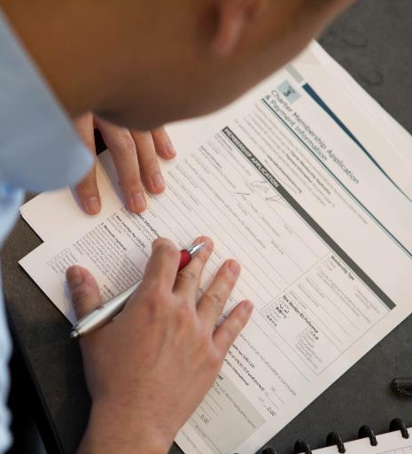
Start your club today!
Identify 20 or more employees to join your club
Secure a designated place to hold club meetings
Fill out and submit the Application to Organize and the charter fee
Club Growth Director will guide you through the final steps
For more information or if you have any
questions, please call +1 720-439-5050 and
ask for the New Clubs team or email newclubs@toastmasters.org
Notes:
Here’s what you need to do to start your club today. First, you need to identify 20 or more employees to join your club. Next, secure a designated place to hold your club meetings – this can be a conference room, break room or whatever space you have available – in or out of the office. Then, fill out and submit the Application to Organize, along with the charter fee. I will be here to guide you through the final steps. Again, if you have any questions along the way, feel free to call World Headquarters and ask for the New Clubs team or send them an email. Are you ready to get started?

